Slide 2
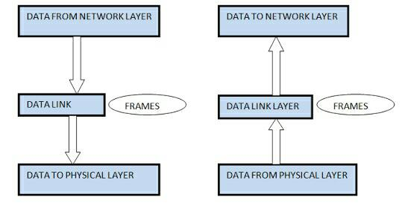
Data link layer
The main task of data link layer are :
Transfer data from network layer of one machine to network layer of another machine using hop by hop transmission.
Convert the raw bit stream of physical layer into group of bits called “Frames”.

Slide 3
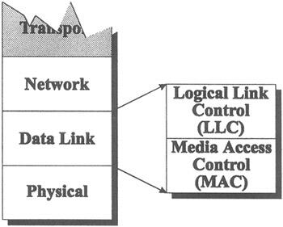
Sublayers of Data Link Layer
Data link layer has two sublayers :
Logical Link Control (LLC)
Media Access Control (MAC)

Slide 4
Logical Link Control (LLC)
Frames the network layer packet
Identifies the network layer packet
Media Access Control (MAC)
Addresses the frame
Marks the beginning and ending of the frame

Slide 5
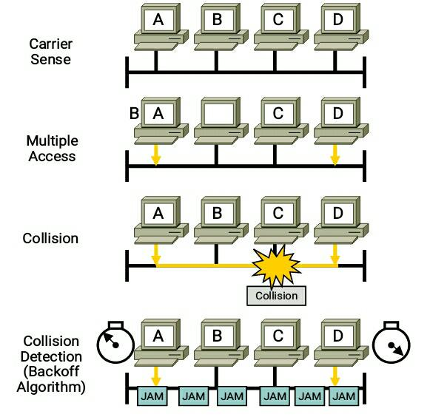
Media Access Control (MAC)
Multiple Access Protocol
CSMA/CD (Carrier Sense Multiple Access/Collision Detection)

Slide 6
CSMA/CA ( Carrier Sense Multiple Access / Collision Avoidance)
It is protocol to prevent collision before they happen.
It checks the channel before transmiting the packet.
If the channel is clear, the packet is sent otherwise it waits for period of time and checks again if the channel is clear.
The period of time is called the backoff factor and counted down by a backoff counter.

Slide 7
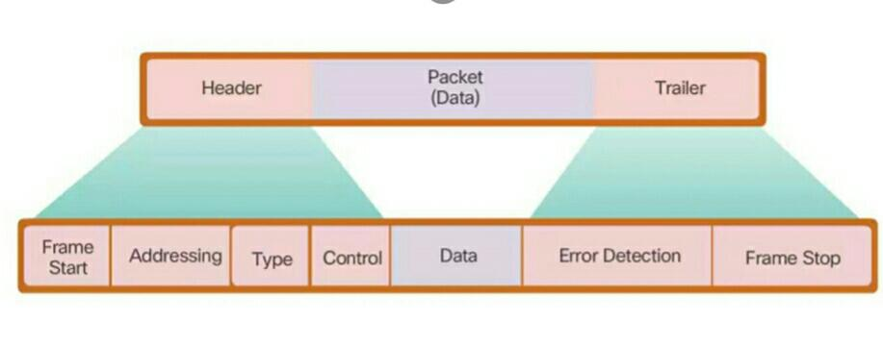
Services of Data Link Layer
Flow Control : pacing between adjacent sending and receiving nodes.
Framing : Large block of data is converted into small frames. The frame contains 3 parts – Header, Data and Trailer
Error Detection : Error occurs due to change in bit during transmission or reception due to noise, signal attenuation etc. It is achieved by error detecting code that is function of bits being transmitted.
Error Correction : Capable of detecting and correcting the bit(s) error without resorting for transmission.

Slide 8
Protocols of data link layer
Address Resolution Protocol (ARP) – Each host has ARP table. It is used to find the MAC address of given IP address.
Asynchronous Transfer Mode (ATM) – It uses asynchronous TDM and encodes data into small, fixed size cells.
Point-to-Point Protocol (PPP) – It provides a standard method for transporting packets in the form of frames over peer-to-peer links.
High Level Data Link Control (HDLC) – It is bit oriented protocol used for error free transmission of data and control the speed at which data is transmitted.

Slide 9
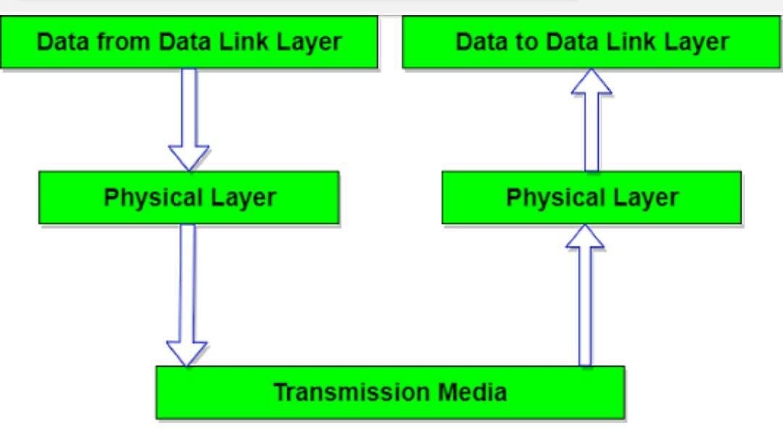
Physical Layer
It is the lowest layer of the OSI reference model.
It is responsible for sending bits from one computer to another.
It deals with the setup of physical connection in the network and with transmission and reception of signals.

Slide 10
Functions of Physical Layer
Representation of bits – It encodes the bits (0 and 1) into signal for transmission and also defines the type of encoding.
Data Rate – It defines the rate of transmission which is the number of bits per second.
Synchronization – The sender and receiver are synchronized at bit level.
Interface – It defines the transmission interface between devices and transmission medium.
Line Configuration – It connects devices with the medium : Point to Point and Multipoint configuration.
Topologies – It defines how devices are connected using following topologies : Mesh, Star, Ring and Bus.
Transmission Modes – It defines the direction of transmission between two devices : Simplex, Half Duplex and Full Duplex.

Slide 11
Services of Physical Layer
Bit-by-bit delivery.
Modulates the process of converting a signal from one form to another so that it can be transmitted.
Line coding, which allows data to be sent by hardware devices that are optimized for digital communications.
Circuit switching
Multiplexing - Establishment and termination of circuit switched connections.
Carrier sensing and collision detection.
Signal equalization to ensure reliable connections and facilitate multiplexing.
Forward error correction such as error correction code.
Bit interleaving to improve error correction.
Providing a standardized interface to a physical transmission medium.
Point-to-point, multipoint or point-to-multipoint line Configuration.

Slide 12
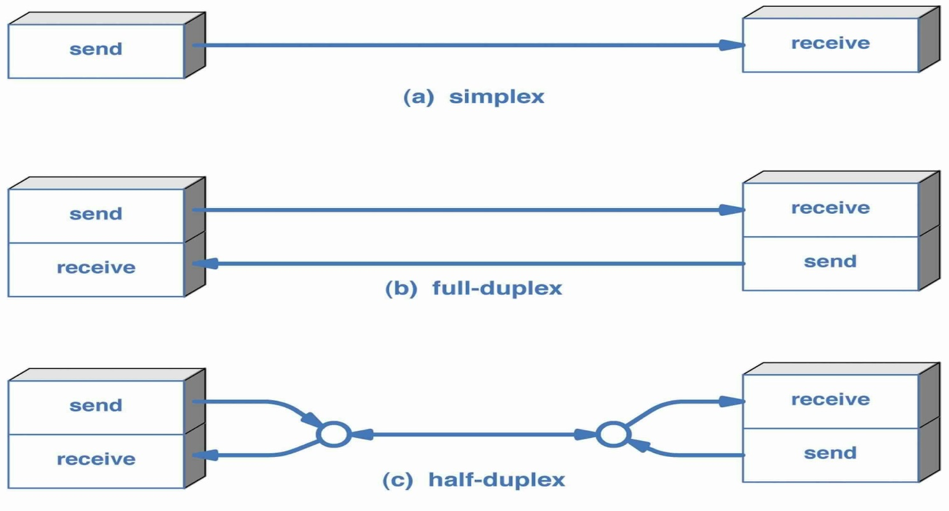
The physical layer is also concerned with :
Bit rate – is the total number of physically transferred bits per second.
Point-to-point, multipoint or point-to-multipoint line configuration.
Serial or parallel communication.
Simplex, half duplex or full duplex transmission mode.

